Slide 1

Research Question – Is there a difference in the mean weekly COVID-19 deaths between high-income and low-income countries?
Group Name: Name of Student Presenting: Purna Satish Dasari

Slide 2
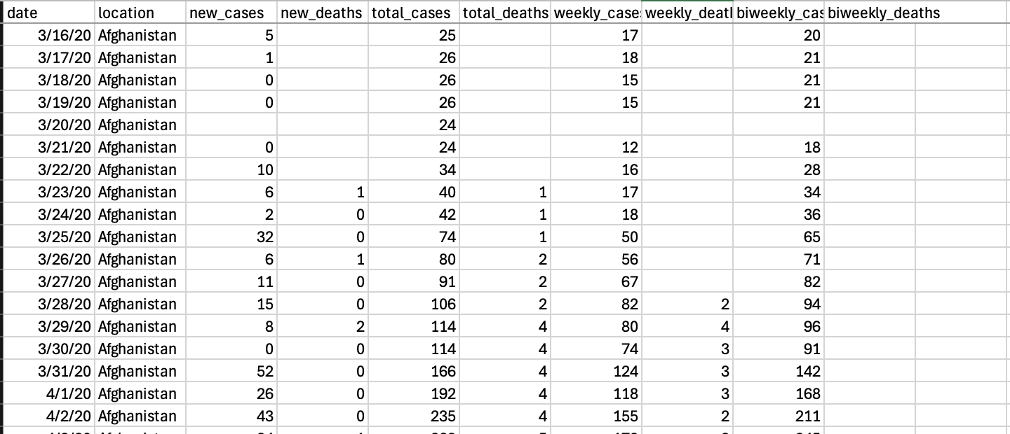
‘new_cases’ and ‘new_deaths’
Here is a sample of our dataset:

Slide 3
This dataset is interesting to us because : This dataset is interesting to us because it contains global COVID-19 daily statistics across many countries and income groups , including weekly death counts. This allows us to compare morality
Our Independent variable is: (High income / Low income)
This Independent variable datatype is (select one): Categorical/Nominal data.
Our Dependent variable is: (weekly_deaths)
This Dependent variable datatype is (select one): Continous/Interval-ratio measurement data
Dataset ID: ds030, full_data.csv
Notes:
Before specifying your Research Question you must define the type of data you are analysing. Are the variables you select interval data (measurement data you can divide, multiple, etc), OR are they ordinal (there is a definite order but the intervals between each variable are not necessarily equal, or the terms might be subjective like in a likert scale); OR are they just categorical/nominal (Items such as film names, cities, etc., that you can count numbers of occurrences? You also need to understand whether the variable is either dependent or independent and this will vary according to the context. Independent variables may cause an effect, whereas the dependent variable might be effected by the independent variable. Check the lecture notes on the RQ for more information and examples.
You will get only one opportunity to present your Research Question ahead of the submission date. Have your questions ready, and be ready to take notes on feedback.

Slide 4
Template ^{2:} Comparision of means: “Is there a difference in the mean weekly COVID-19 deaths between high-income and low-income countries?? ”
Our Research Question is: Is there a significant difference in the mean weekly deaths per million population between high income and low income countries ?
¹Correlation (Analysis of how ordinal/interval dependent var correlates to an ordinal/interval independent variable)
²Comparison of means (or medians): Analysis of the difference between the mean (or median) value of a characteristic shared by members of two different populations.
³Comparison of proportions: Analysis of the difference in proportions of a characteristic shared by members of two different populations.

Slide 5
Add your Hypotheses to the previous RQ Slide (both the Null and Alternative Hypotheses). Here are definitions and examples. Your hypothesis wording comes directly from your RQ. This is the formal way of reporting the results of your inferential test statistics, in which we report the effect the independent variable has on the dependent variable –
Null hypothesis (H₀): There is no difference in the mean weekly deaths between high-income and low-income countries.
2. Alternative hypothesis (H₁): There is a difference in the mean weekly deaths between high-income and low-income countries.
Leave the hypotheses as two statements for now – after your statistical analysis test, you will choose one or the other. (You will report: "We fail to reject the null hypothesis" with no significant result, or if you do have significance [p-value = < 0.05] you can state "We reject the null hypothesis". More guidance on hypothesis testing is given in the lectures.)

